Slide 1
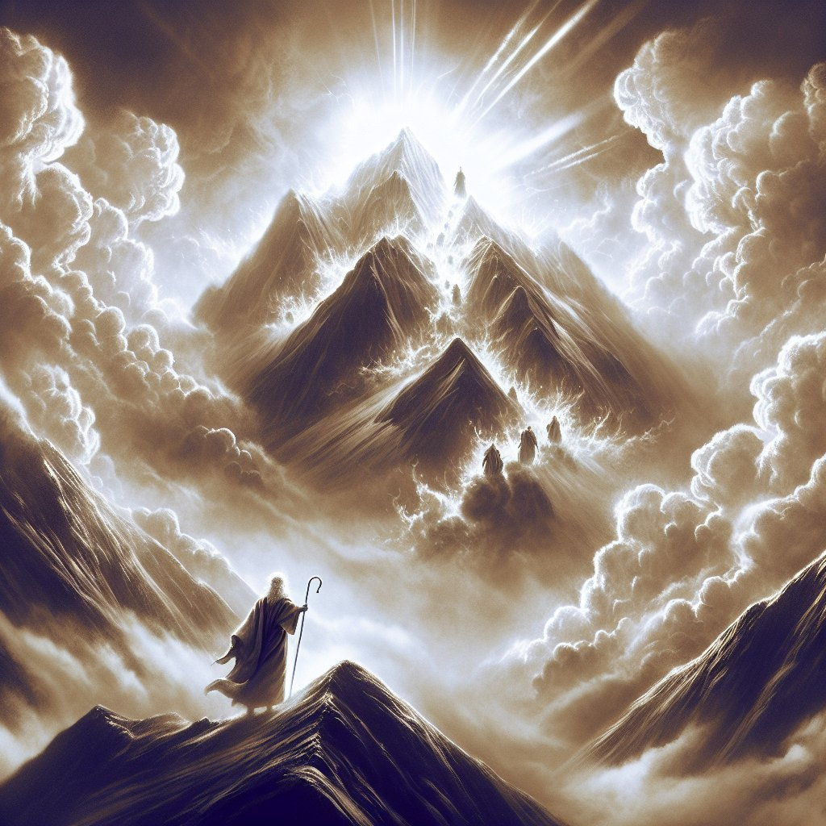
Divine Alignment: When Moses Got in Sync with God

Slide 2
Exodus 32:7-14
⁷ Then the Lord said to Moses, “Go down, because your people, whom you brought up out of Egypt, have become corrupt. ⁸ They have been quick to turn away from what I commanded them and have made themselves an idol cast in the shape of a calf. They have bowed down to it and sacrificed to it and have said, ‘These are your gods, Israel, who brought you up out of Egypt.’
⁹ “I have seen these people,” the Lord said to Moses, “and they are a stiff-necked people. ¹⁰ Now leave me alone so that my anger may burn against them and that I may destroy them. Then I will make you into a great nation.”
¹¹ But Moses sought the favour of the Lord his God. “Lord,” he said, “why should your anger burn against your people, whom you brought out of Egypt with great power and a mighty hand? ¹² Why should the Egyptians say, ‘It was with evil intent that he brought them out, to kill them in the mountains and to wipe them off the face of the earth’? Turn from your fierce anger; relent and do not bring disaster on your people. ¹³ Remember your servants Abraham, Isaac and Israel, to whom you swore by your own self: ‘I will make your descendants as numerous as the stars in the sky and I will give your descendants all this land I promised them, and it will be their inheritance forever.’” ¹⁴ Then the Lord relented and did not bring on his people the disaster he had threatened.

Slide 3
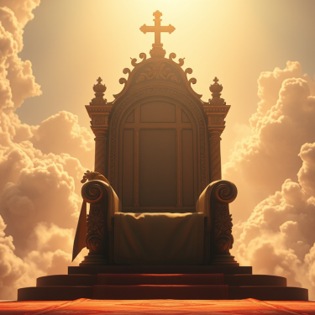
Hebrews 4:16
16 Let us then with confidence draw near to the throne of grace, that we may receive mercy and find grace to help in time of need.
1 John 5:14-15
And this is the confidence that we have toward him, that if we ask anything according to his will he hears us. And if we know that he hears us in whatever we ask, we know that we have the requests that we have asked of him.

Slide 4
Luke 18:13-14
But the tax collector, standing far off, would not even lift up his eyes to heaven, but beat his breast, saying, ‘God, be merciful to me, a sinner!’ I tell you, this man went down to his house justified, rather than the other.
James 4:10
Humble yourselves before the Lord, and he will exalt you.

Slide 5
Exodus 33:12-23
¹² Moses said to the Lord, “You have been telling me, ‘Lead these people,’ but you have not let me know whom you will send with me. You have said, ‘I know you by name and you have found favour with me.’ ¹³ If you are pleased with me, teach me your ways so I may know you and continue to find Favor with you. Remember that this nation is your people.” ¹⁴ The Lord replied, “My Presence will go with you, and I will give you rest.”
¹⁵ Then Moses said to him, “If your Presence does not go with us, do not send us up from here. ¹⁶ How will anyone know that you are pleased with me and with your people unless you go with us? What else will distinguish me and your people from all the other people on the face of the earth?”
¹⁷ And the Lord said to Moses, “I will do the very thing you have asked, because I am pleased with you and I know you by name.” ¹⁸ Then Moses said, “Now show me your glory.”
¹⁹ And the Lord said, “I will cause all my goodness to pass in front of you, and I will proclaim my name, the Lord, in your presence. I will have mercy on whom I will have mercy, and I will have compassion on whom I will have compassion. ²⁰ But,” he said, “you cannot see my face, for no one may see me and live.”
²¹ Then the Lord said, “There is a place near me where you may stand on a rock. ²² When my glory passes by, I will put you in a cleft in the rock and cover you with my hand until I have passed by. ²³ Then I will remove my hand and you will see my back; but my face must not be seen.”

Slide 6
Matthew 6:33
33 But seek first his kingdom and his righteousness, and all these things will be given to you as well

Slide 7
Matthew 28:20
And behold, I am with you always, to the end of the age.
John 14:16-17
And I will ask the Father, and he will give you another Helper, to be with you forever, even the Spirit of truth, whom the world cannot receive, because it neither sees him nor knows him. You know him, for he dwells with you and will be in you.

Slide 8
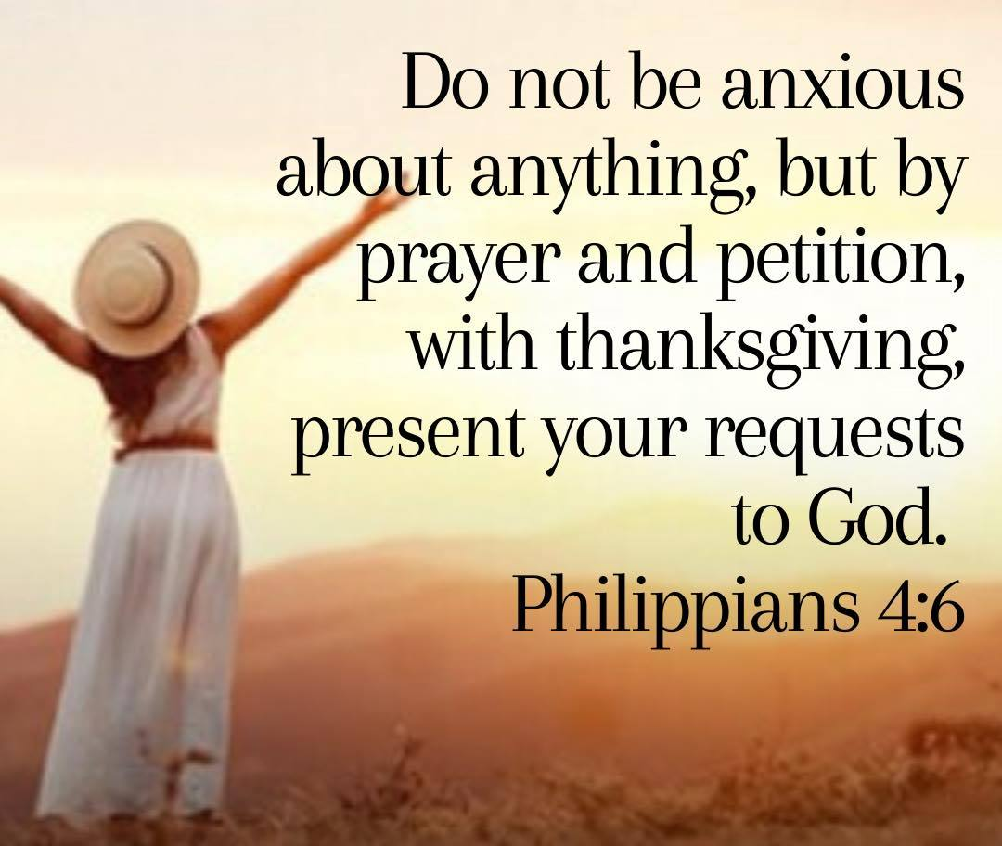
Philippians 4:6-7
Do not be anxious about anything, but in every situation, by prayer and petition, with thanksgiving, present your requests to God. And the peace of God, which transcends all understanding, will guard your hearts and your minds in Christ Jesus.

